Slide 1
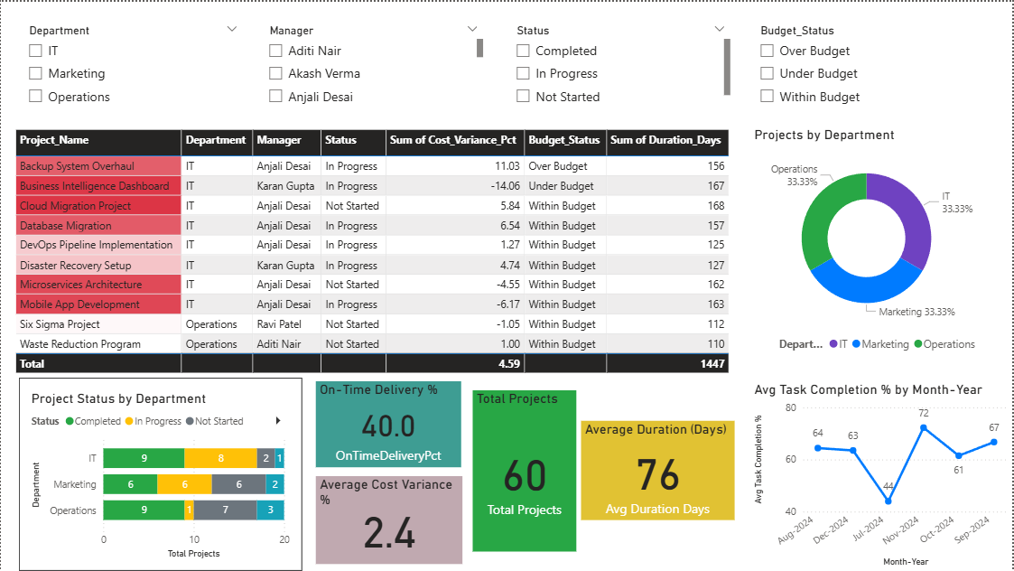
EXECUTABLE OVERVIEW Q4 2025

Slide 2
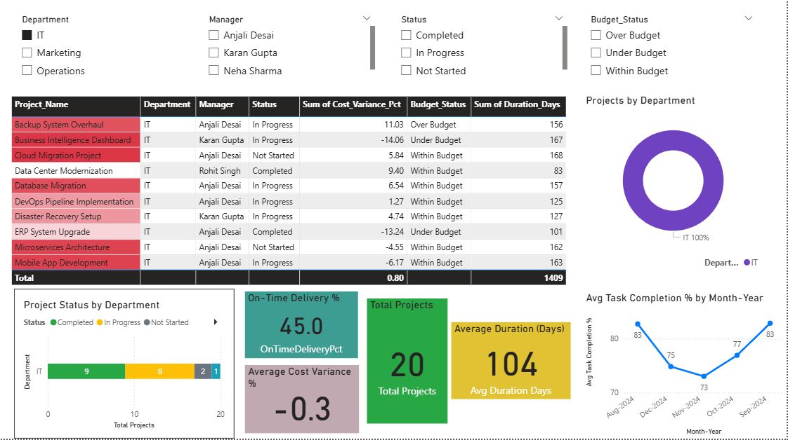
SELECTING DEPARTEMENT –IT :

Slide 3
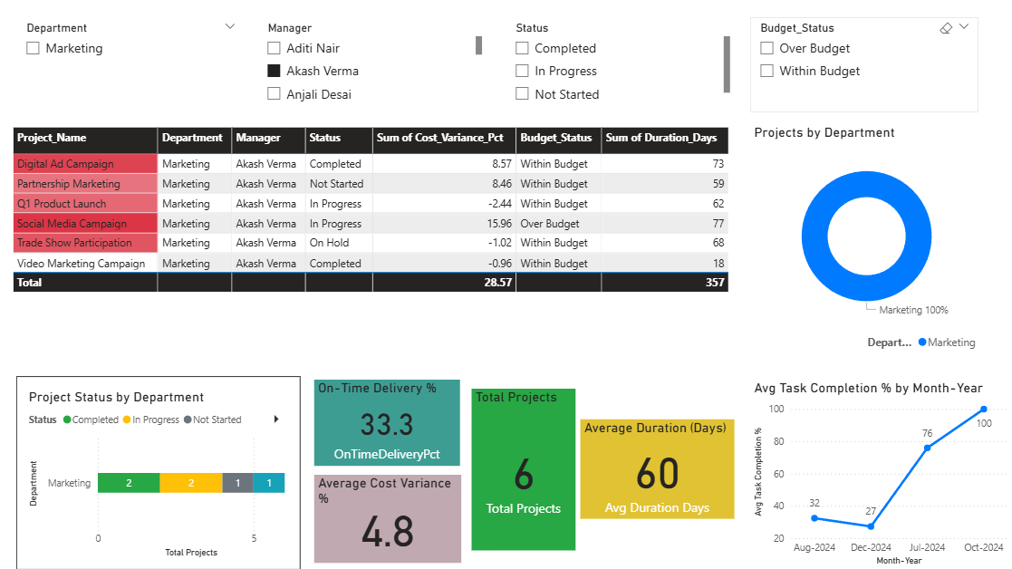
SELECTING MANAGER – AKASH VERMA :

Slide 4
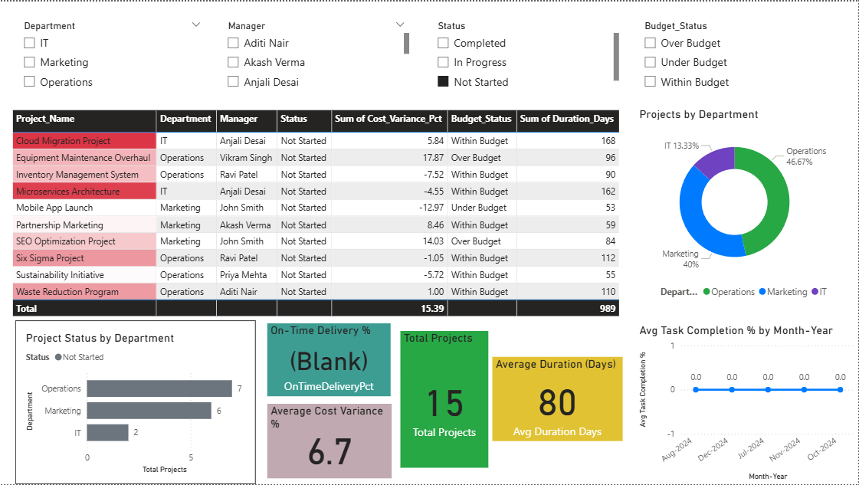
SELECTING STATUS –NOT STARTED :

Slide 5
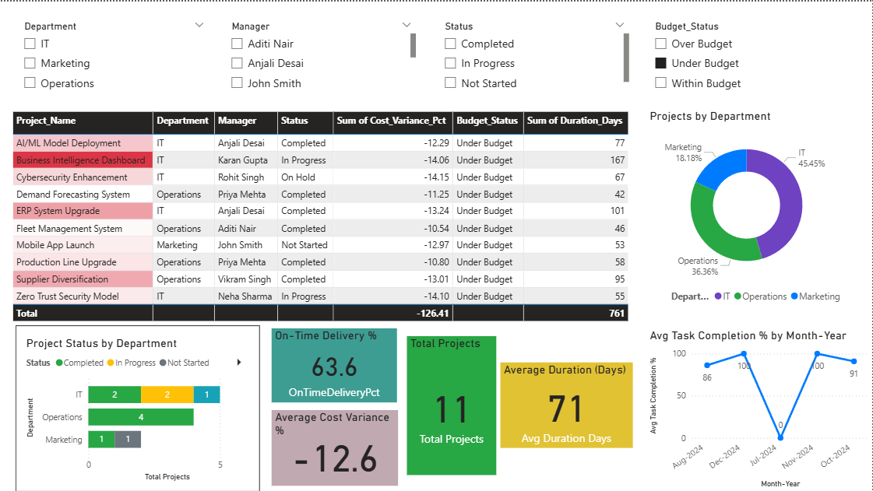
SELECTING BUDGE STATUS – UNDER BUDGET :

Slide 6
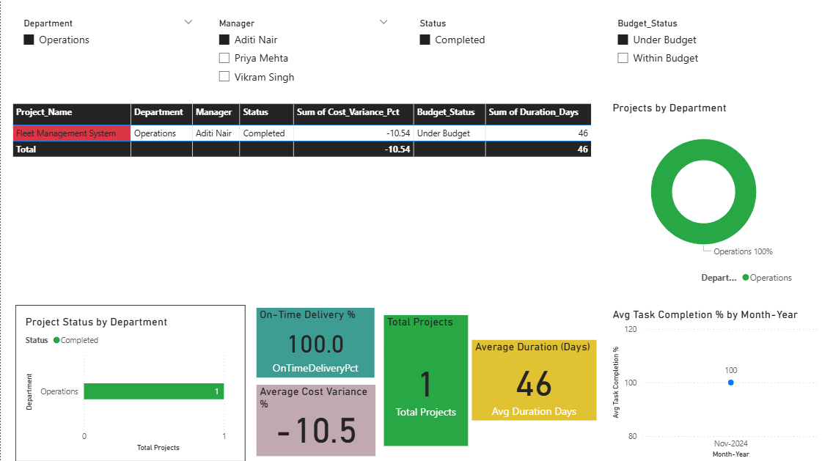
SELECTING MULTIPLE OPTIONS AT ONCE :

